Slide 1



Presentation
The new RMDs’
pre-washing system
using Sodium Bicarbonate

Slide 2
RMDs PRE-WASHING SYSTEM
The new way of cleaning

Slide 3
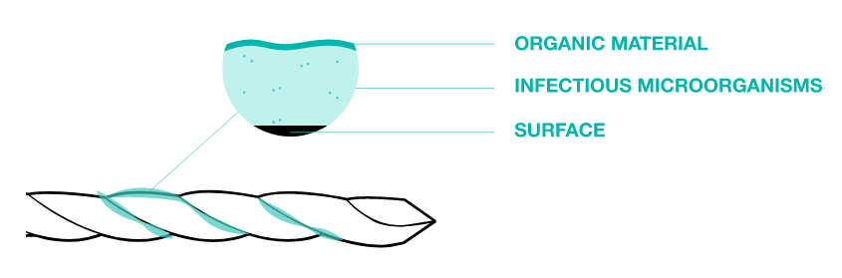
PRE-WASING IS IMPORTANT
Adequate cleaning is necessary to obtain sterility.
Cleaning is the first step in re-processing a device after use.
Incorrect cleaning of an instrument can let in dirt material outside and inside the device preventing the disinfection and sterilization process.

Slide 4
PRE-WASING IS IMPORTANT
Adequate cleaning is necessary to obtain sterility.
An adequate cleaning:
Drastically reduces microbiological contamination (BIOBOURDEN)
Improves the contact between the disinfectant / sterilizing agent and the infectious microorganisms left on the surfaces
Guarantees instruments functionality and longevity

Slide 5
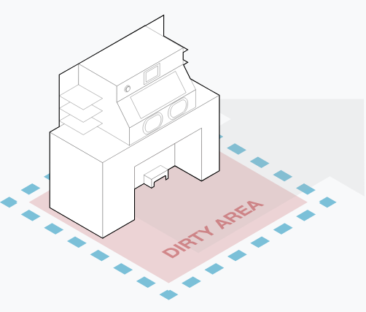
BICARmed ® PRE-WASING SYSTEM
The cleaning that improves reprocessing performances
DIRTY AREA
BICARmed® is a new revolutionary cleaning system for the pre-treatment of all RMDs before to be subjected to disinfection and / or sterilization washing processes.

Slide 6
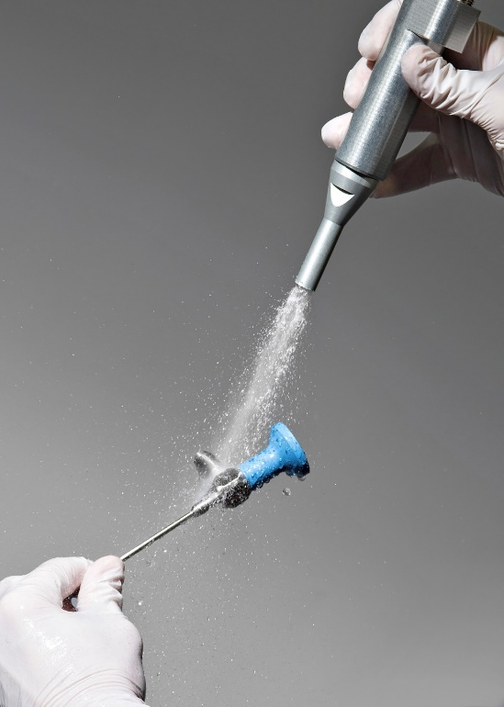
BICARmed ® PRE-WASING SYSTEM
The cleaning that improves reprocessing performances
ONE WAY FOR ALL INSTRUMENTS
BICARmed® treatment can be carried out, with the same effectiveness, on all instruments typologies.
Even the most complex one.

Slide 7
SAFE CleanBox
TECHNOLOGY

Slide 8
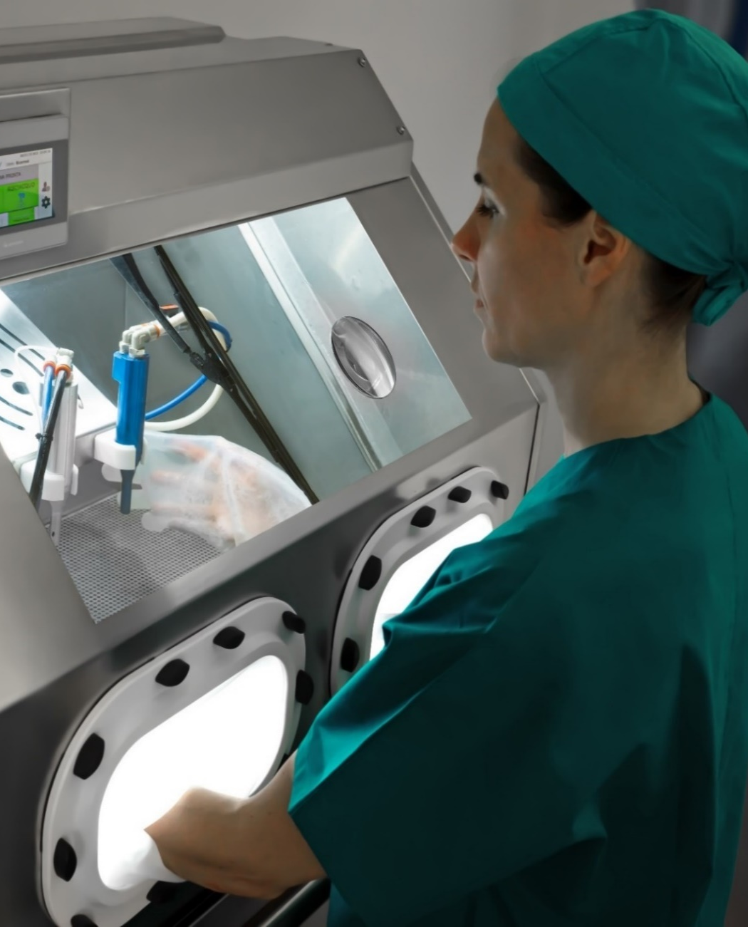
SAFE CleanBox
BICARmed® Technology
SAFE CleanBox is a medical device in class 1 - CE marked certified.
The system uses sodium bicarbonate in granules and low pressure compressed air to clean all reusable medical device.

Slide 9
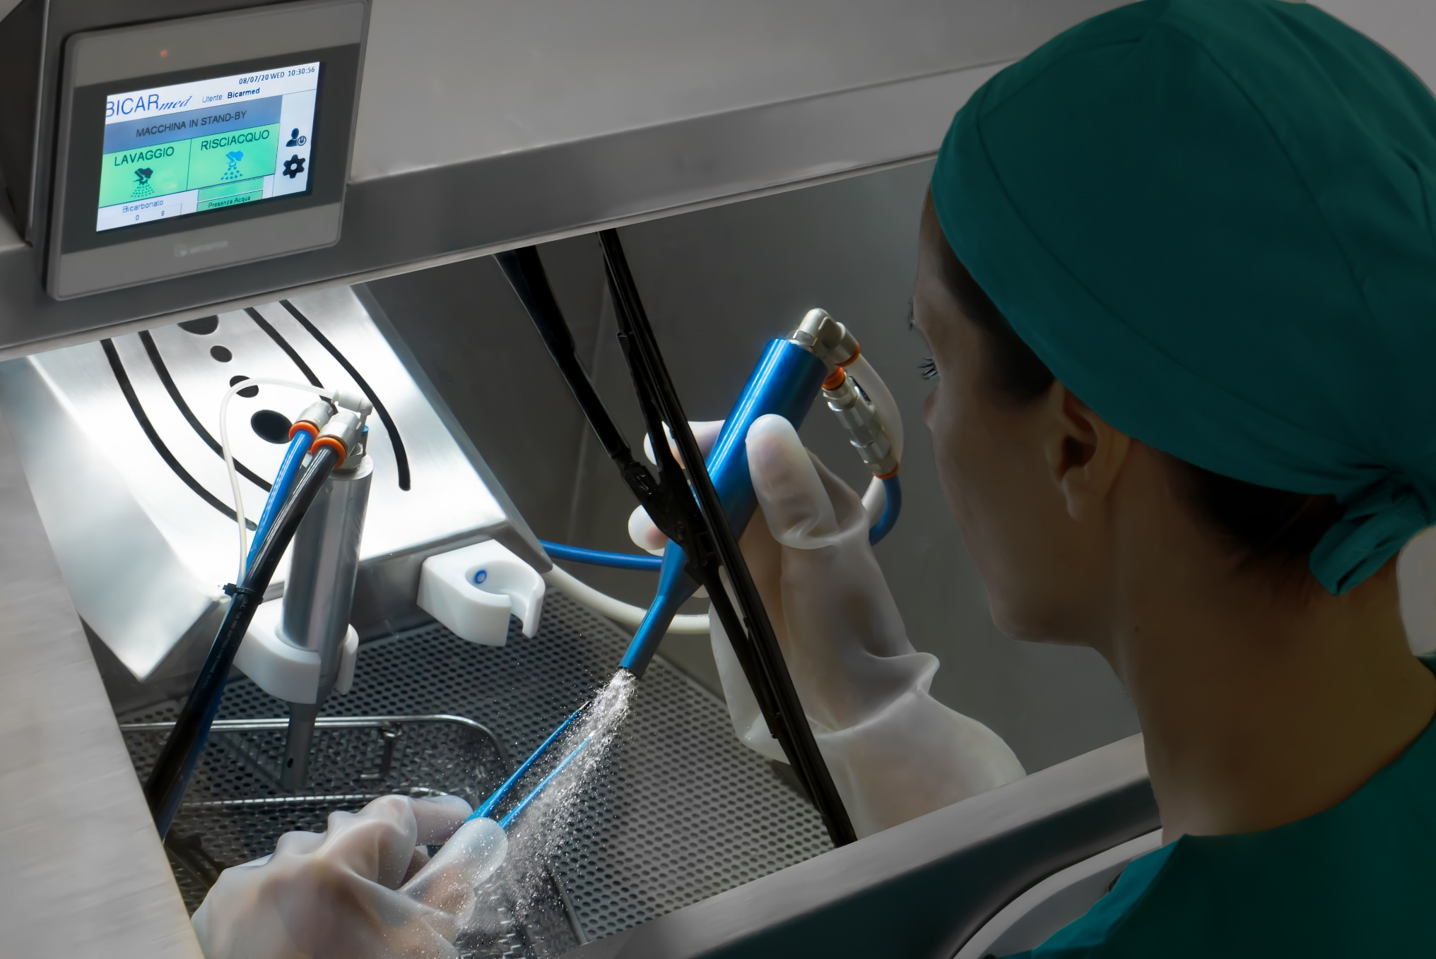
HOW DOES IT WORK?
Easy, fast, efficient
A flow of sodium bicarbonate with air and water, conveyed through a handpiece, strikes the instrument surface uniformly and continuously.
The dirt is thus removed in depth, even from the most complex geometries and with the most adherent contaminants.
Through a second handpiece it is possible the complete rinsing of the tool.

Slide 10
ADVANTAGE

Slide 11



ADVANTAGE
EFFECTIVE
SAFE
ECONOMICAL
Maximum removal of difficult dirt - bone, cements, glue and dry blood residues -
even on the more complex RMDs geometries.
Prevents direct contact between the operator and unsafe contaminants.
The sodium bicarbonate preserves the surface of the instruments.
Significant reduction on maintenance of RMDs.
Wear prevention by oxidation, corrosion, pitting and biofilm extending RMDs’ lifecycle.

Slide 12
ADVANTAGE
EFFECTIVE
1

Slide 13


EFFECTIVE
Ensured Maximum Efficiency on all type of tools and dirts
Critical Tools
Critical Dirts
TOOLS WITH COMPLEX SHAPES AND GEOMETRIES AS:
  ENDOSCOPIC TOOLS
  CANNULATED TOOLS
  ORTHOPEDIC TOOLS
ELECTROSURGERY TOOLS
DELICATE MICROSURGERY TOOLS
RIGID OPTICS
ROBOTIC TOOLS
NON-SUBMERSIBLE TOOLS
HEAVY DIRT
DRY DIRT
RESIDUES FROM CAUTERIZATION PRACTICES
INORGANIC RESIDUES
BONE RESIDUES
CEMENT RESIDUES
GLUE RESIDUES

Slide 14
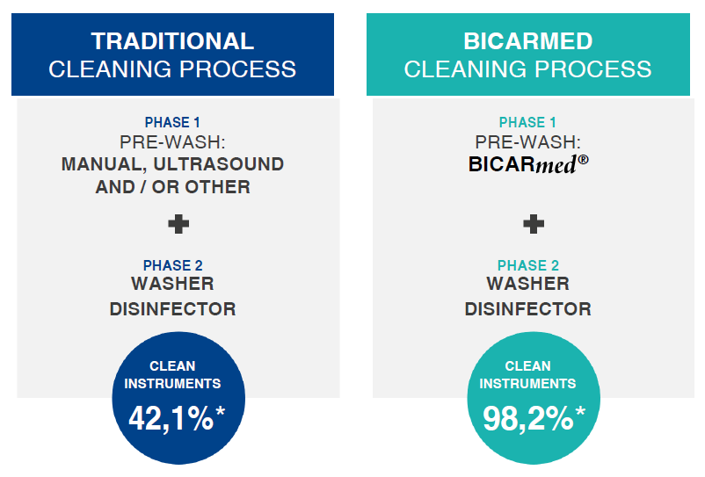
EFFECTIVENESS IN COMPARISON

Slide 15
ADVANTAGE
SAFE
2

Slide 16
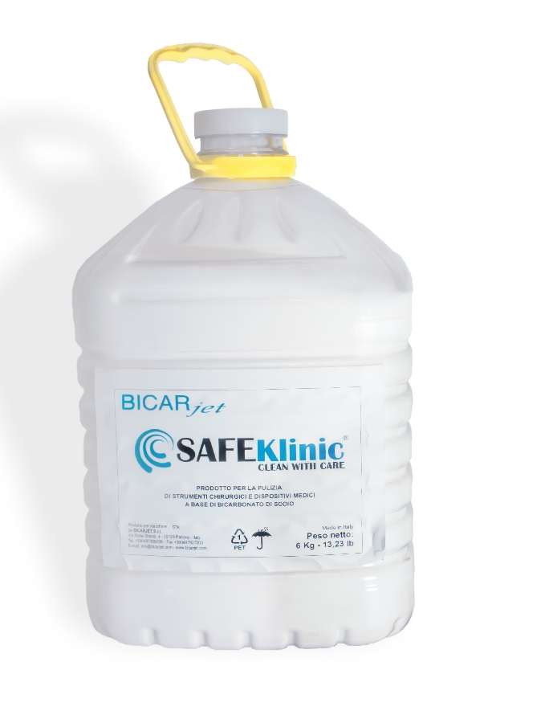
SAFE
Just Sodium Bicarbonate
BICARmed ® treatment guarantees effective cleaning without any aggressive substances.
SAFE for the OPERATOR
SAFE for the INSTRUMENT
SAFE for the ENVIRONMENT

Slide 17

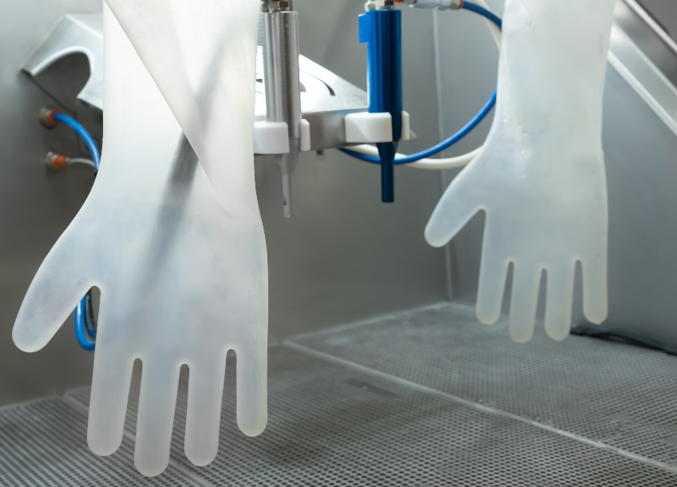
SAFE
Better protection, operator safety
Closed cabin to isolate the working area
No contact with dangerous contaminants
Cut resistant gloves

Slide 18

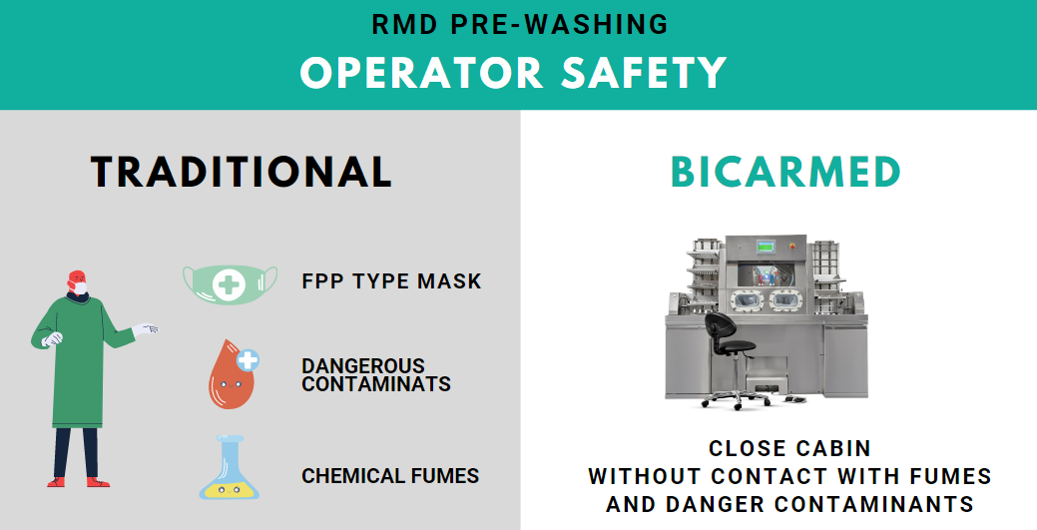

Slide 19
SAFE
Delicate on instruments
The sodium Bicarbonate is non-abrasive and non-corrosive.
It preserves the instruments surface and removes Biofilm.

Slide 20
ADVANTAGE
ECONOMICAL
3

Slide 21


ECONOMICAL
Quality beyond expectations
BICARmed treatment extends the life cycle of instruments.
Cleaning instruments in depth:
Removes the Biofilm
Reduces instrument damage from Oxidation.

Slide 22
SAFEKlinic
SODIUM BICARBONATE

Slide 23



WHY SAFEKlinic SODIUM BICARBONATE?
Accurate, Delicate, Safe
Effectiveness and precision of BICARmed ed treatment is due to the combination of two forces: emollient and mechanical action of SafeKlinic sodium bicarbonate.
NO-ABRASIVE
NO-CORROSIVE
EFFECTIVE ON
COMPLEX SHAPES AND DIRT
STUDIED GRANULOMETRY

Slide 24
WHY SAFEKlinic SODIUM BICARBONATE?
Accurate
BICARmed ®treatment accuracy derives from the constant and continuous action of the sodium bicarbonate: projected on the surface, bicarbonate is capable to hit the same point repeatedly and continuously over and over again.
This action makes the BICARmed ® process comparable to a highly efficient mechanical brushing. Simulations show that one second of treatment with the BICARmed ® process is equivalent to 40 seconds of manual brushing.
It allows to treat and remove any type of contaminant from any type of reusable surgical instrument.
EFFECTIVE ON
COMPLEX SHAPES AND DIRT

Slide 25
WHY SAFEKlinic SODIUM BICARBONATE?
Delicate
Compressed air supplies the kinetic energy to the solid sodium bicarbonate particles that mechanically act on the surface of the instrument.
As shown by the study of the Metallurgy Department of Trento University, the sodium bicarbonate granules are destroyed by impact with the surface by absorbing all the kinetic energy without altering or damaging the treated surface.
Thanks to the water presence it operates an emollient "chemical" action that allows you to maximize detersion with cold water without using dangerous chemicals.
NO-ABRASIVE
NO-CORROSIVE

Slide 26
WHY SAFEKlinic SODIUM BICARBONATE?
Safe for the instruments
The special granulometry of SafeKlinic bicarbonate, specifically studied to reduce dustiness to a minimum, allows to treat cavities less than 100 µ with great effectiveness and accuracy and to flush all cannulated instruments maintaining their patency and thus avoiding the risk of obstruction.
Sodium bicarbonate has a pH 8, it can be discharged into sewage after the complete dissolution into water, without pollution and/or overloading the sewage treatment plant.
SAFEKlinic ® is non-corrosive and biodegradable.
STUDIED GRANULOMETRY

Slide 27
BEFORE AND AFTER
CLEANING EXAMPLES

Slide 28




Organic tissues fixed on FORCEPS
Before BICARmed treatment
After BICARmed treatment
Organic tissues fixed on
FORCEPS
After BICARmed treatment
Before BICARmed treatment
After BICARmed treatment

Slide 29




Organic tissues fixed on ACETABULUM backside
Before BICARmed treatment
After BICARmed treatment
Organic tissues fixed on
ACETABULUM
backside
After BICARmed treatment
Before BICARmed treatment
After BICARmed treatment

Slide 30




Oxidation on GRIPPER CLAMP
Before BICARmed treatment
After BICARmed treatment
Organic tissues fixed on
DRILL BIT
After BICARmed treatment
Before BICARmed treatment
After BICARmed treatment

Slide 31




Organic tissues fixed on
MONOPOLAR TWEEZERS
Before BICARmed treatment
After BICARmed treatment
Organic tissues fixed on
MONOPOLAR TWEEZERS
After BICARmed treatment
Before BICARmed treatment
After BICARmed treatment

Slide 32




Organic tissues fixed on
BIPOLAR TWEEZERS
Before BICARmed treatment
After BICARmed treatment
Organic tissues fixed on
BIPOLAR TWEEZERS
After BICARmed treatment
Before BICARmed treatment
After BICARmed treatment

Slide 33




Organic tissues fixed on
ENDOSCOPIC FORCEPS
Before BICARmed treatment
After BICARmed treatment
Organic tissues fixed on
ENDOSCOPIC FORCEPS
After BICARmed treatment
Before BICARmed treatment
After BICARmed treatment

Slide 34




Organic tissues fixed on
ENDOSCOPIC FORCEPS
Before BICARmed treatment
After BICARmed treatment
Organic tissues fixed on
ENDOSCOPIC FORCEPS
After BICARmed treatment
Before BICARmed treatment
After BICARmed treatment

Slide 35




Organic tissues fixed on ENDOSCOPIC FORCEPS
Before BICARmed treatment
After BICARmed treatment
Organic tissues fixed on
LAPAROSCOPIC FORCEPS
After BICARmed treatment
Before BICARmed treatment
After BICARmed treatment

Slide 36




Organic tissues fixed on
ROBOTIC
INSTRUMENTS
Before BICARmed treatment
After BICARmed treatment
Organic tissues fixed on
ROBOTIC
INSTRUMENTS
After BICARmed treatment
Before BICARmed treatment
After BICARmed treatment

Slide 37




Organic tissues fixed on
DA VINCI
ROBOT
Before BICARmed treatment
After BICARmed treatment
Organic tissues fixed on
DA VINCI
ROBOT
After BICARmed treatment
Before BICARmed treatment
After BICARmed treatment

Slide 38




Organic dried tissues fixed on RIGID OPTIC
Before BICARmed treatment
After BICARmed treatment

Slide 39
MODELS
SAFE CleanBox STK 102 – 103 -113
SAFE CleanBox STK 100

Slide 40

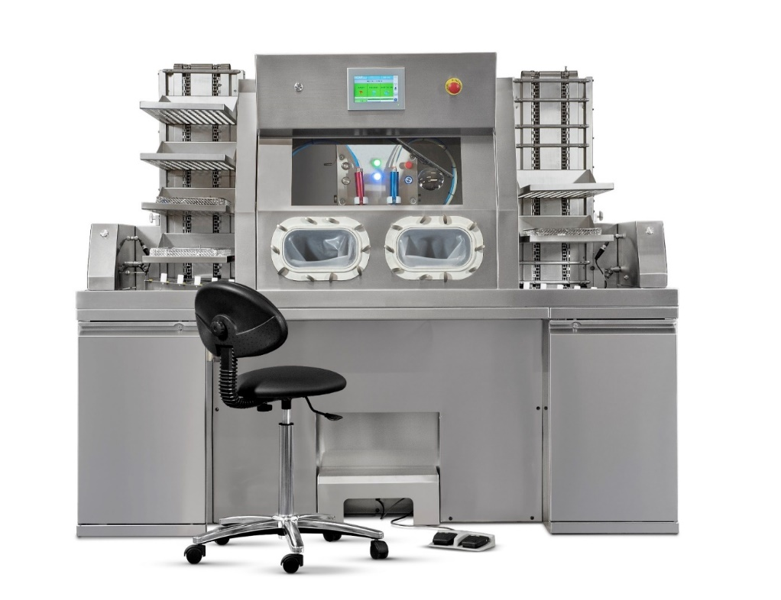

SUGGEST FOR CSSD
AUTOMATIC LOADERS FOR INTENSIVE WORKLOAD
WORK WHILE SITTING
INTERNAL TOUCH CONTROL PANEL
SAFE CleanBox
STK113

Slide 41
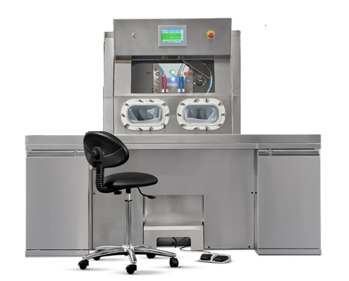

SUGGEST FOR CSSD
WITHOUT LOADERS
WORK WHILE SITTING
INTERNAL TOUCH CONTROL PANEL
SAFE CleanBox
STK103

Slide 42
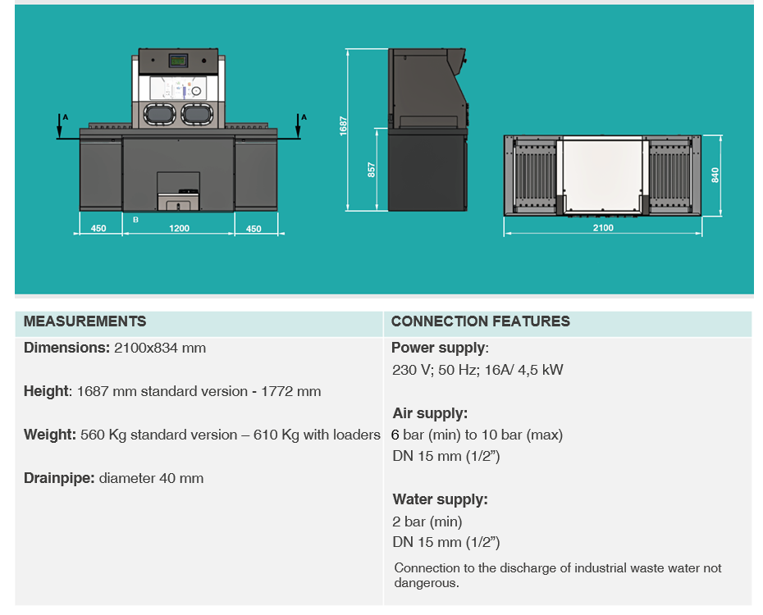
STK 103-113
CONNECTIONS AND MEASUREMENTS

Slide 43
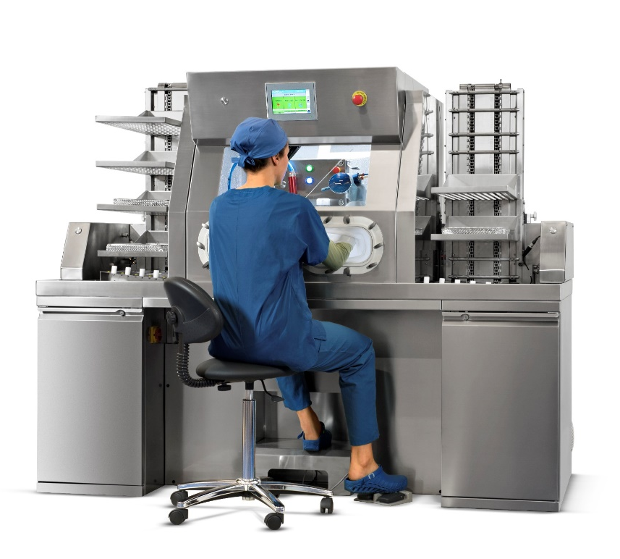
STK 103 - 113
FIELD OF APPLICATION
SAFE CleanBox STK 103 -113 is a studied solution for the pre-treatment of RMDs in CSSD dirt area.
Mainly used for heavy workflow, you can work while seated.
Thanks to the automatic doors, the tray loaders and the internal touch control panel you can work without moving from the workstation.
Possibility of sanitizing the internal walls of the cabin at the end of the work day.

Slide 44
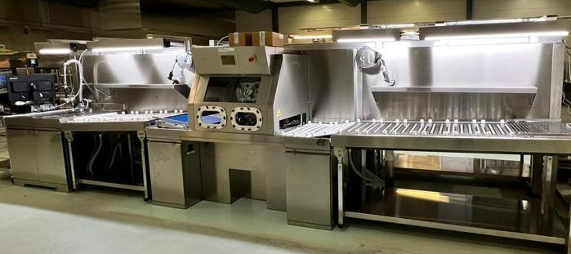
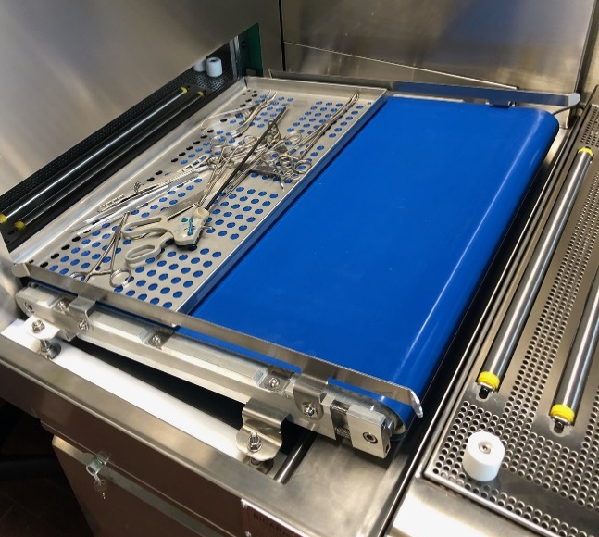
STK 102
LINE

Slide 45
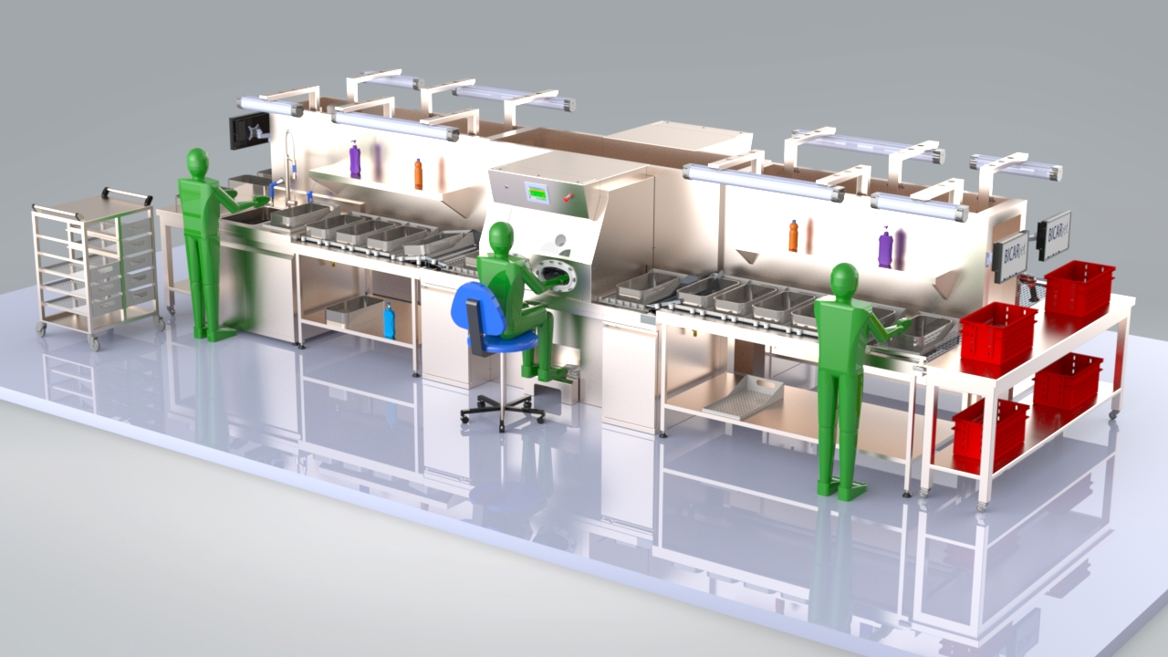
STK 102
LINE

Slide 46
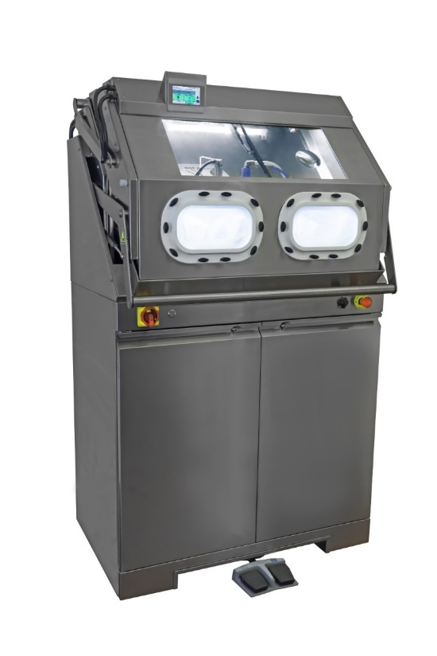
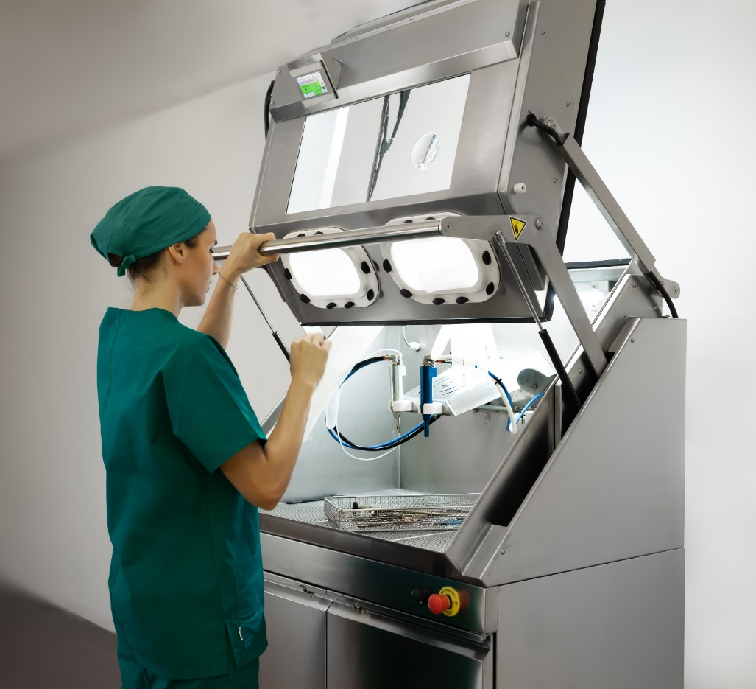
SUGGEST FOR SMALL SPACES
LOW WORKFLOW
STANDING WORK
EXTERNAL CONTROL PANEL
SAFE CleanBox
STK100

Slide 47
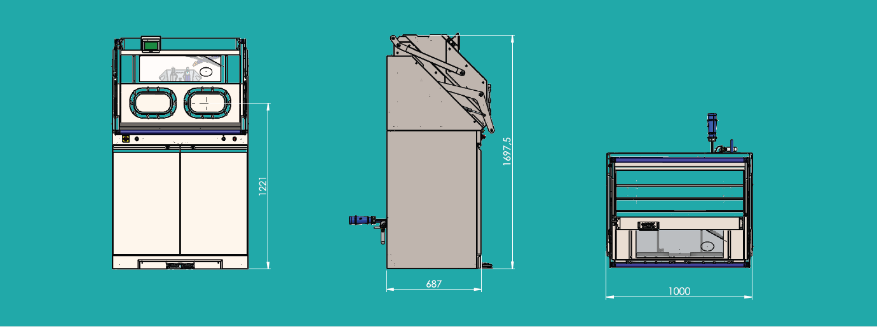
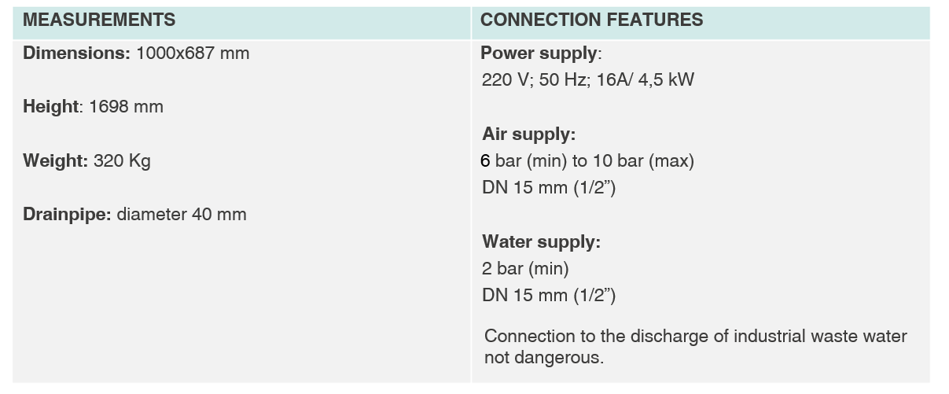
STK 100
CONNECTIONS AND MEASUREMENTS

Slide 48
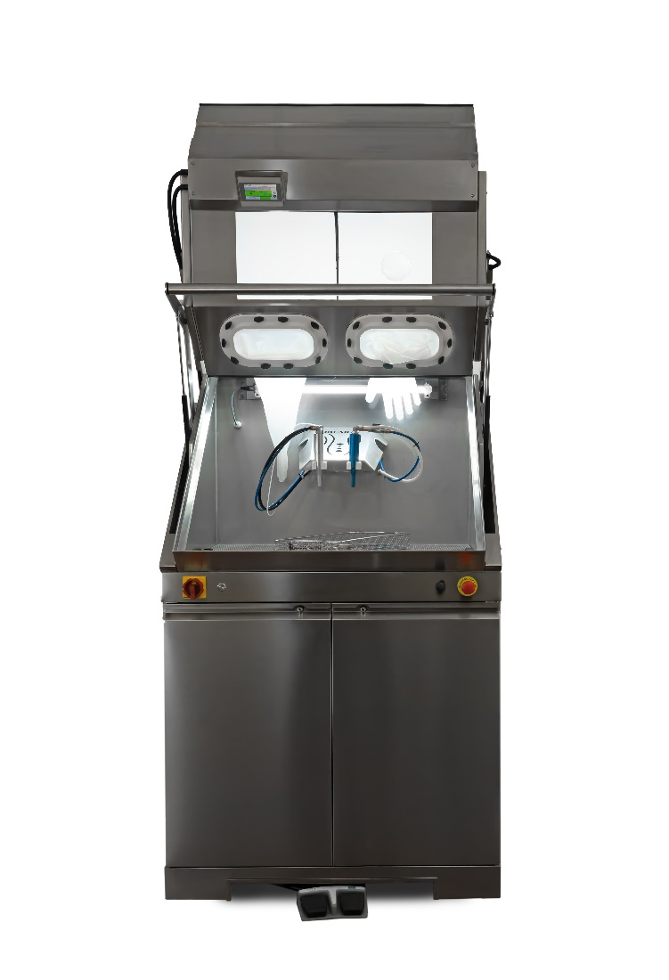
STK 100
FIELD OF APPLICATION
SAFE
CleanBox STK 100 is studied solution for the pre-treatment of RMDs in all contexts in which the storage and / or transit time results prolonged.
SAFE CleanBox STK 100 prevents dirt from becoming permanently sticked, thus preventing oxidation or sticking of organic material (biofilm).
Immediate cleaning of the instruments also allows to reduce the stress caused by the halides partially present in biological and physiological liquids.

Slide 49
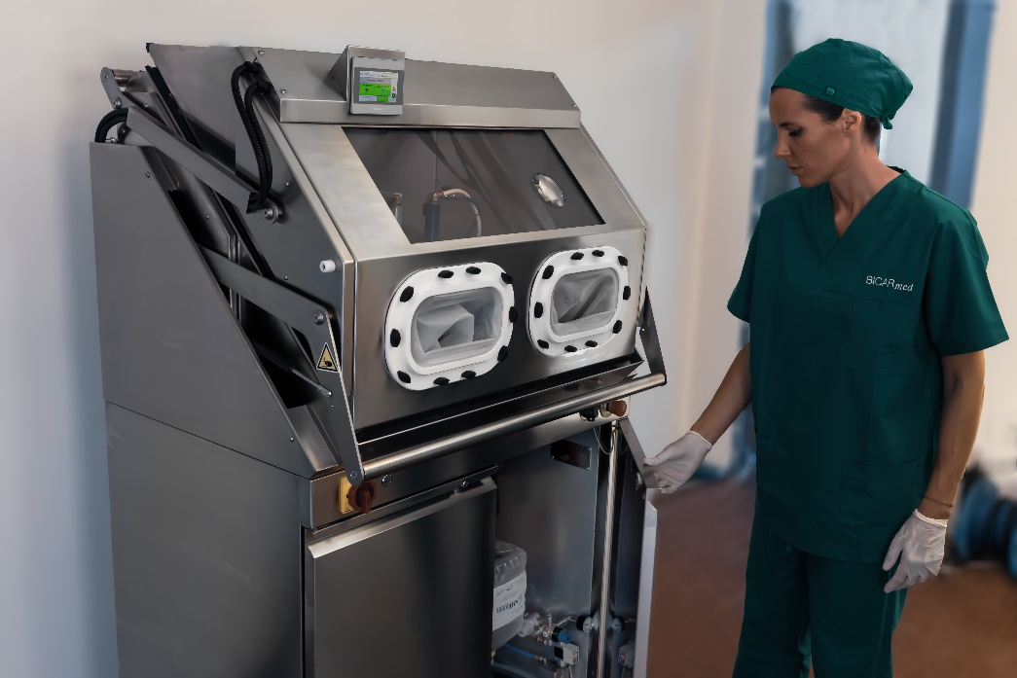
STK 100
FIELD OF APPLICATION
Machine has following placings:
Sub-sterilization central
Specialistic operating rooms
Maintenance laboratories

Slide 50
CERTIFICATIONS AND PATENTS
Made in Italy
ALL SAFE CleanBox Models are CE certified and marked as Class I Medical Devices, in compliance with European Directive 2017/745/EEC.
BICARmed ® holds 4 registered and recognized patents.

Slide 51
CONSUMABLE
SAFEKlinic Sodium Bicarbonate
SANYSAFE

Slide 52
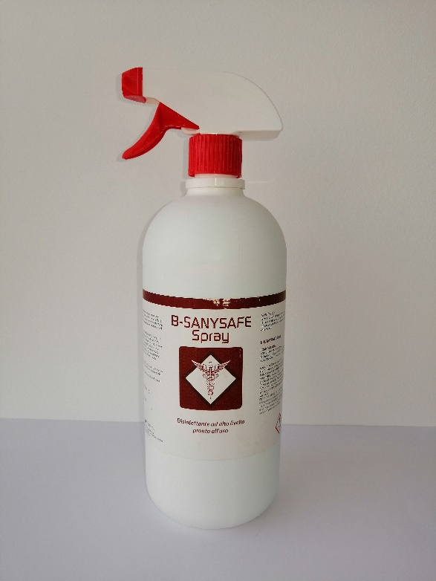
CONSUMABLES
SAFEKlinic Sodium bicarbonate and Sanysafe

Slide 53
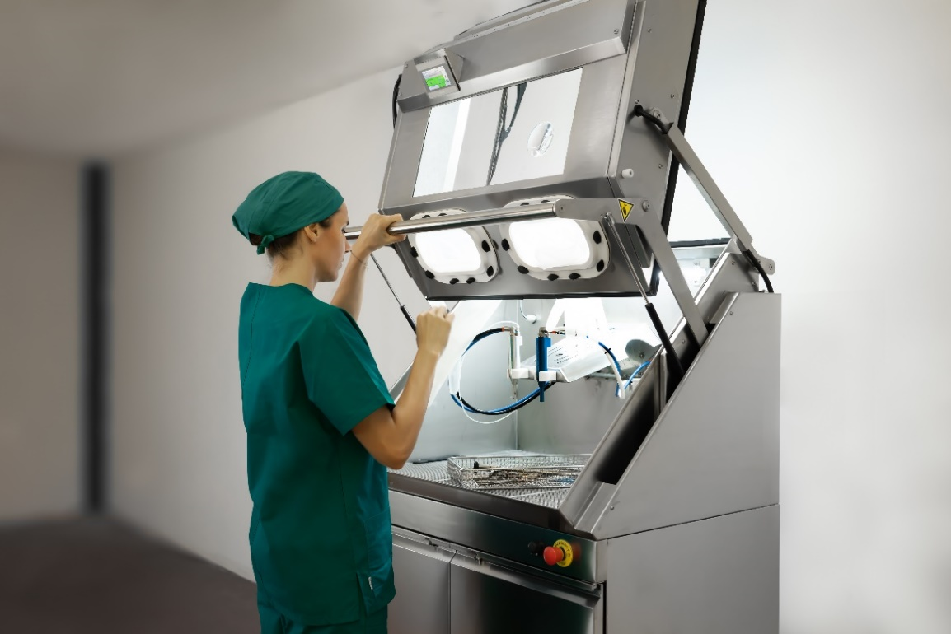
ALL THE CLEANING OPERATIONS
CAN BE DONE WITH THE SAME TECHNOLOGY

Slide 54
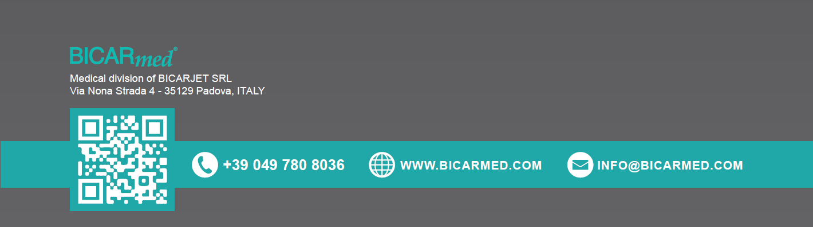
THANKS FOR YOUR ATTENTION

