Slide 1


Presentation
The new RMDs’
pre-washing system
using Sodium Bicarbonate

Slide 2


ABOUT BICARjet®
Sodium bicarbonate Systems
35 YEARS EXPERIENCE
PARTNER SOLVAY
FOR SODIUM BICARBONATE
8 PATENTS
2 MANUFACTORING PLANTS

Slide 3





Medical Division
Industrial Division

Slide 4

ABOUT BICARmed®
Medical Division of BICARjet
BICARmed® Division was created 10 years ago applying the experience of BICARjet ® to RMD’s cleaning:
PARTNERSHIP WITH UNIVERSITY
TESTED BY HOSPITALS
4 INTERNATIONAL PATENTS
8 YEARS OF R&D
ABOUT BICARMED

Slide 5
BICARmed PRE-WASHING
THE NEW WAY OF CLEANING

Slide 6
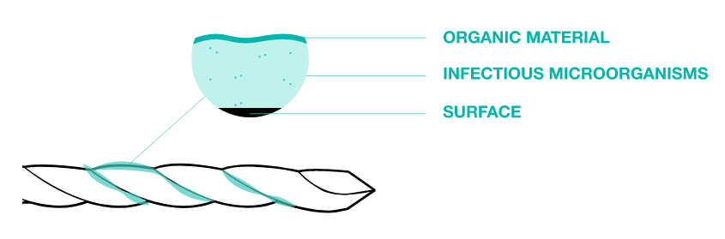
PRE-WASING IS IMPORTANT
Adequate cleaning is necessary to obtain sterility.
Cleaning is the first step in re-processing a device after use.
Incorrect cleaning of an instrument can let in dirt material outside and inside the device preventing the disinfection and sterilization process.

Slide 7
PRE-WASING IS IMPORTANT
Adequate cleaning is necessary to obtain sterility.
Pre-washing phase is important because it removes the residues of organic and inorganic substances from the surfaces of medical devices.
An adequate cleaning:
Drastically reduces microbiological contamination (BIOBOURDEN)
Improves the contact between the disinfectant / sterilizing agent and the infectious microorganisms left on the surfaces
Guarantees instruments functionality and longevity

Slide 8
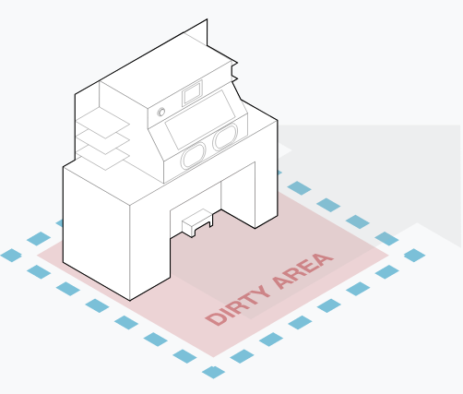
BICARmed ® PRE-WASING SYSTEM
The cleaning that improves performances
BICARmed® is a new revolutionary cleaning system for the pre-treatment of all RMDs before to be subjected to disinfection and / or sterilization washing processes.
BICARmed® revolutionizes the RMD cleaning notion because the treatment can be carried out, with the same effectiveness, on all instruments typologies, in order to remove even the most difficult dirt, significantly increasing the whole process performances.

Slide 9
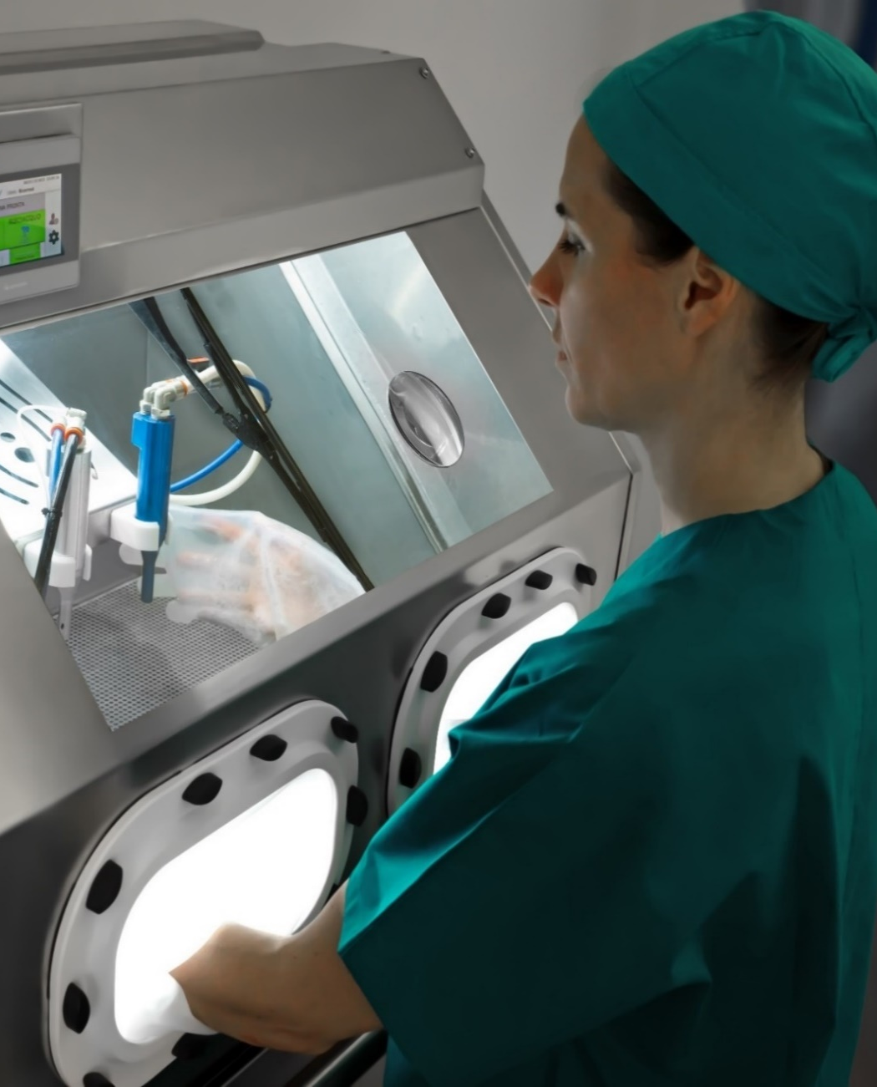
SAFE CleanBox
The BICARmed® Technology
BICARmed ® SAFE CleanBox is a medical device - CE marked certified - for the pretreatment of RMDs before to be subjected to disinfection and / or sterilization washing processes.
Machine consists of a cabin similar in shape to a "glove box".
The system uses sodium bicarbonate in granules and low pressure compressed air to clean all reusable medical device

Slide 10
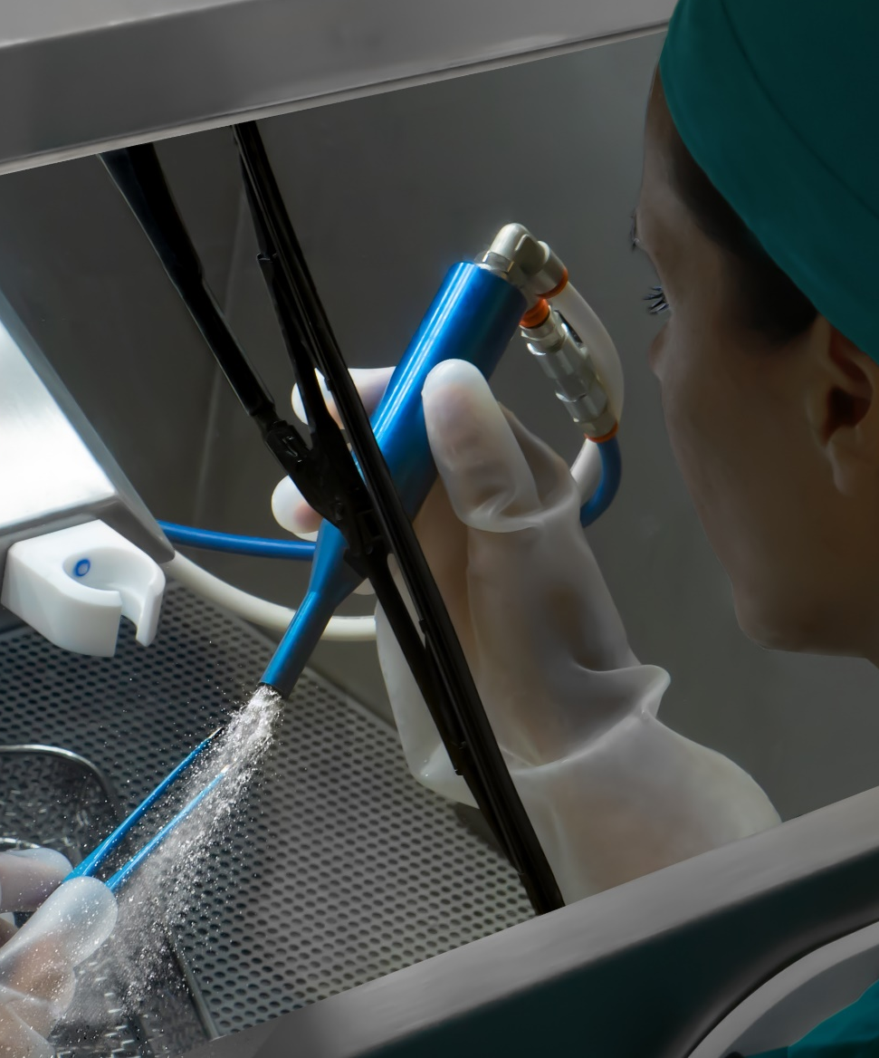
HOW DOES IT WORK?
Easy, fast, efficient
A flow of sodium bicarbonate special size with air and water conveyed through a handpiece, strikes the surface uniformly and continuously.
The dirt is thus removed in depth, even from the most complex geometries and with the most adherent contaminants.
Through a second handpiece it is possible the complete rinsing of the tool.

Slide 11
ADVANTAGE
BICARmed TECHNOLOGY

Slide 12



ADVANTAGE
EFFECTIVE
SAFE
ECONOMICAL
Maximum removal of difficult dirt - bone, cements, glue and dry blood residues -
even on more RMDs with complex geometries.
Prevents direct contact between the operator and unsafe contaminants.
The sodium bicarbonate does not alter but preserves the surface of the instruments.
Significant reduction on maintenance of RMDs.
Wear prevention by oxidation, corrosion, pitting and biofilm extending RMDs’ lifecycle.

Slide 13


EFFECTIVE
Ensured Maximum Efficiency on all type of tools and dirts
Critical Tools
Critical Dirts
TOOLS WITH COMPLEX SHAPES AND GEOMETRIES AS:
  ENDOSCOPIC TOOLS
  CANNULATED TOOLS
  ORTHOPEDIC TOOLS
ELECTROSURGERY TOOLS
DELICATE MICROSURGERY TOOLS
RIGID OPTICS
ROBOTIC TOOLS
NON-SUBMERSIBLE TOOLS
HEAVY DIRT
DRY DIRT
RESIDUES FROM CAUTERIZATION PRACTICES
INORGANIC RESIDUES
BONE RESIDUES
CEMENT RESIDUES
GLUE RESIDUES

Slide 14
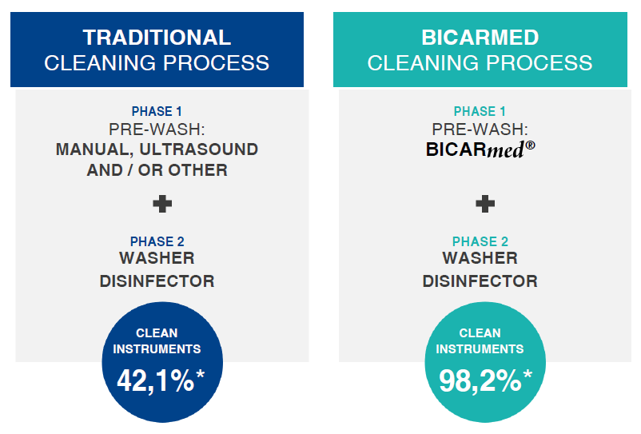
EFFECTIVENESS IN COMPARISON

Slide 15

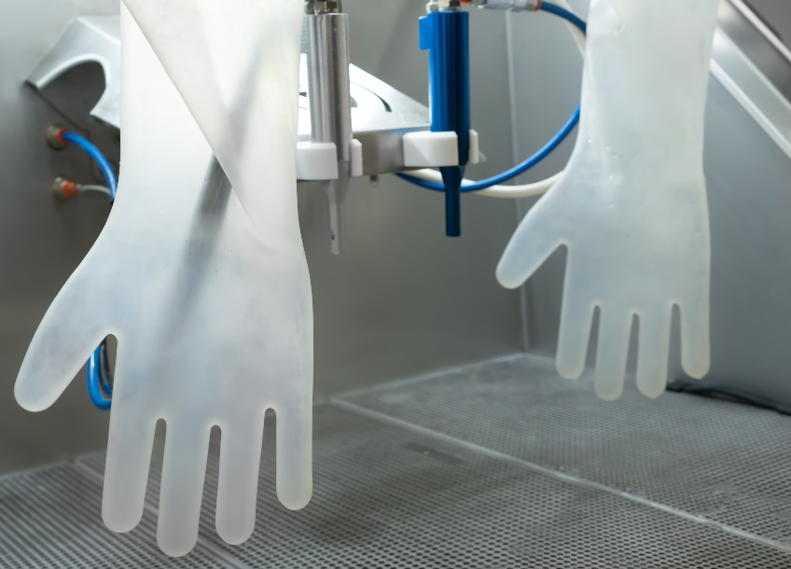
SAFE
Ecofriendly and operator safety
BICARmed ® treatment guarantees effective cleaning without any aggressive substances.
The non-toxicity of sodium bicarbonate and the isolation of the work area that prevents contact with dangerous contaminants guarantees maximum safety for the operator.
Better protection, operator safety:
Closed cabin to isolate the working area
No contact with dangerous contaminants
Cut resistant gloves

Slide 16

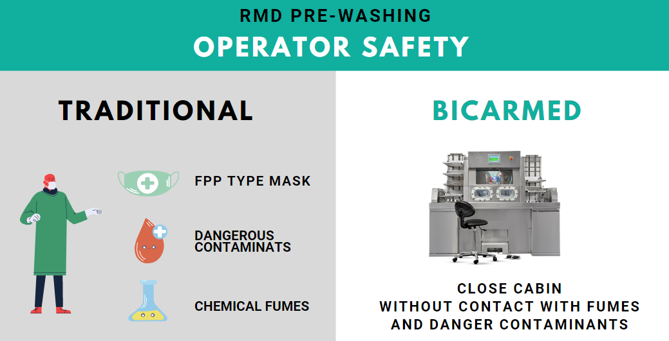

Slide 17


ECONOMICAL
QUALITY BEYOND EXPECTATIONS
BICARmed ® treatment cleans instruments in depht and removes the biofilm, extending the life cycle of instruments. An effective cleaning prevents the accumulation of debris deposits on the instruments’ surface, thus reducing instrument damage from oxidation.
Oxidation creates micro holes on RMD surfaces over time (pitting), of difficult, if not impossible, cleaning, which weakens instruments leading them to early breakage.

Slide 18
SAFEKlinic
SODIUM BICARBONATE

Slide 19



WHY SAFEKlinic SODIUM BICARBONATE?
Accurate, delicate, safe
Effectiveness and precision of BICARmed ® treatment is due to the combination of two forces: emollient and mechanical action of SafeKlinic sodium bicarbonate.
NO-ABRASIVE
NO-CORROSIVE
EFFECTIVE ON
COMPLEX SHAPES AND DIRT
STUDIED GRANULOMETRY

Slide 20
WHY SAFEKlinic SODIUM BICARBONATE?
Accurate
BICARmed ®treatment accuracy derives from the constant and continuous action of the sodium bicarbonate: projected on the surface, bicarbonate is capable to hit the same point repeatedly and continuously over and over again.
This action makes the BICARmed ® process comparable to a highly efficient mechanical brushing. Simulations show that one second of treatment with the BICARmed ® process is equivalent to 40 seconds of manual brushing.
It allows to treat and remove any type of contaminant from any type of reusable surgical instrument.
EFFECTIVE ON
COMPLEX SHAPES AND DIRT

Slide 21
WHY SAFEKlinic SODIUM BICARBONATE?
Delicate
Compressed air supplies the kinetic energy to the solid sodium bicarbonate particles that mechanically act on the surface of the instrument.
As shown by the study of the Metallurgy Department of Trento University, the sodium bicarbonate granules are destroyed by impact with the surface by absorbing all the kinetic energy without altering or damaging the treated surface.
Thanks to the water presence it operates an emollient "chemical" action that allows you to maximize detersion with cold water without using dangerous chemicals.
NO-ABRASIVE
NO-CORROSIVE

Slide 22
WHY SAFEKlinic SODIUM BICARBONATE?
Safe for the instruments
The special granulometry of SafeKlinic ® bicarbonate, specifically studied to reduce dustiness to a minimum, allows to treat cavities less than 100 µ with great effectiveness and accuracy and to flush all cannulated instruments maintaining their patency and thus avoiding the risk of obstruction.
Due to the fact that sodium bicarbonate has a pH 8, it can be discharged into sewage after the complete dissolution into water, without pollution and/or overloading the sewage treatment plant.
SAFEKlinic ® is non-corrosive and biodegradable.
STUDIED GRANULOMETRY

Slide 23
MODELS
SAFE CleanBox STK 102 – 103 -113
SAFE CleanBox STK 100

Slide 24

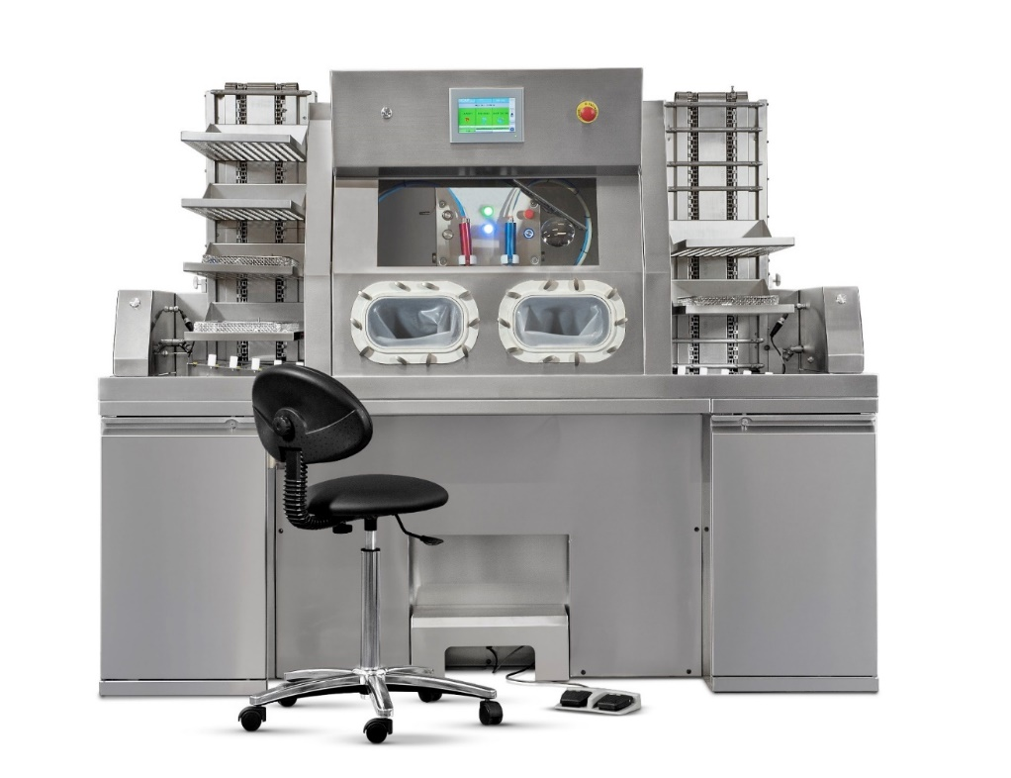

SUGGEST FOR CSSD
AUTOMATIC LOADERS FOR INTENSIVE WORKLOAD
WORK WHILE SITTING
INTERNAL TOUCH CONTROL PANEL
SAFE CleanBox
STK113

Slide 25
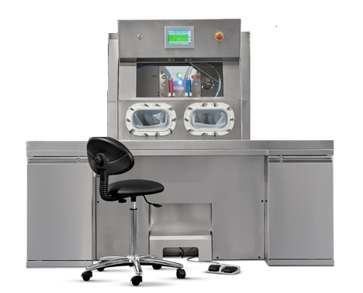
SUGGEST FOR CSSD
WITHOUT LOADERS
WORK WHILE SITTING
INTERNAL TOUCH CONTROL PANEL
SAFE CleanBox
STK103

Slide 26
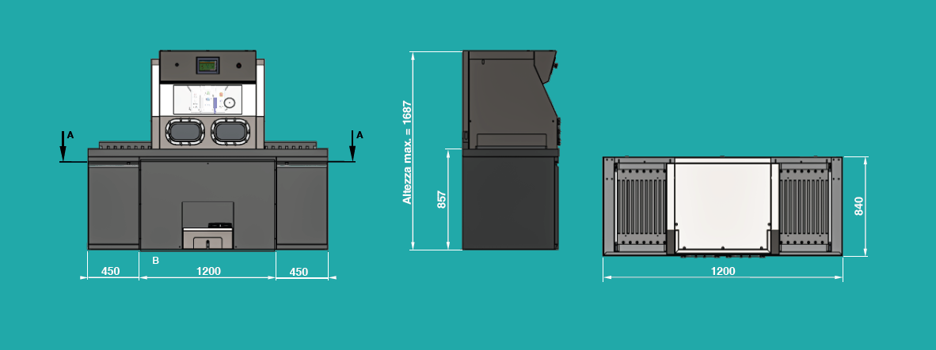
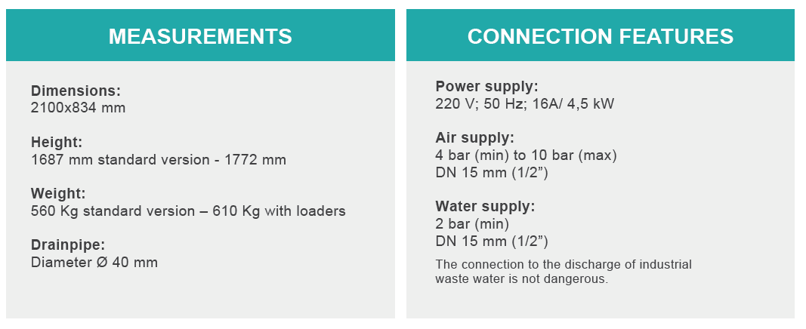
STK 103-113
CONNECTIONS AND MEASUREMENTS

Slide 27
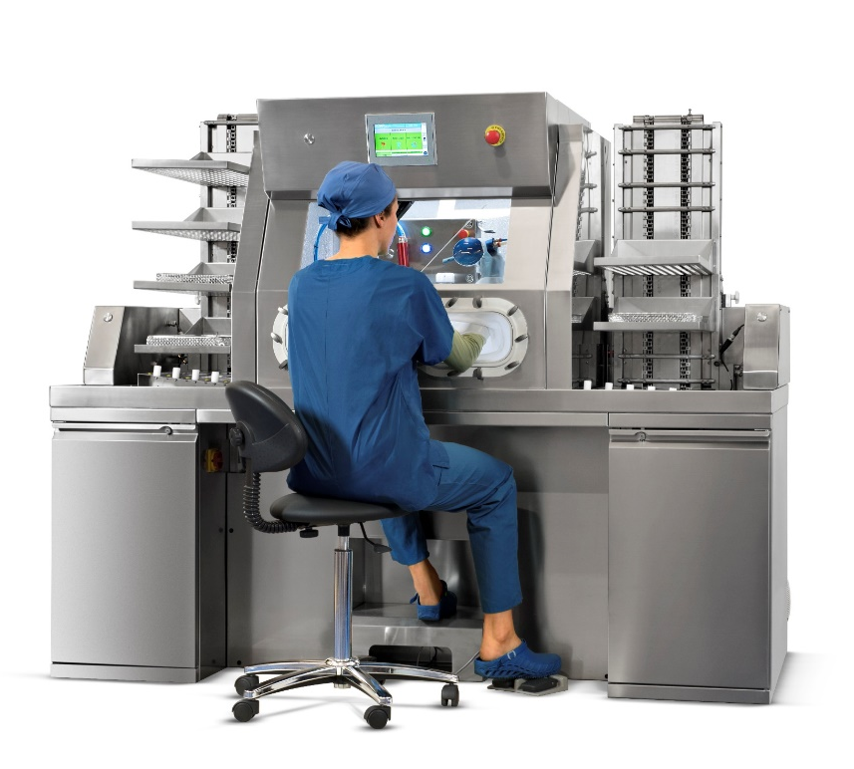
STK 103 - 113
FIELD OF APPLICATION
SAFE CleanBox STK 103 -113 is a studied solution for the pre-treatment of RMDs in CSSD dirt area.
Mainly used for heavy workflow, you can work while
seated.
Thanks to the automatic doors, the tray loaders and the internal touch control panel you can work without moving from the workstation.
Possibility of sanitizing the internal walls of the cabin at the end of the work day.

Slide 28
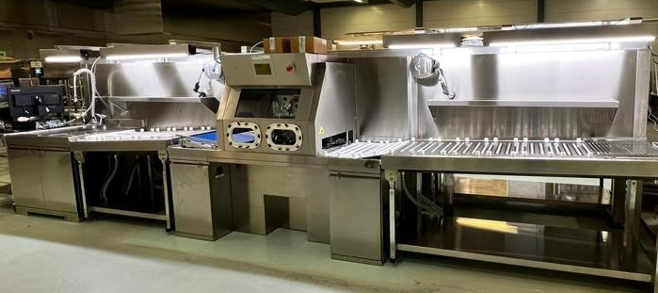
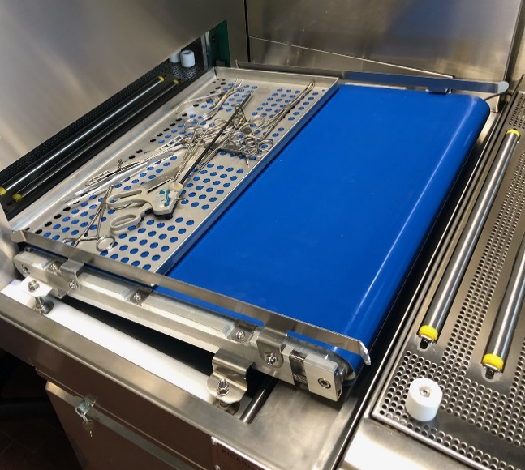
STK 102
LINE

Slide 29
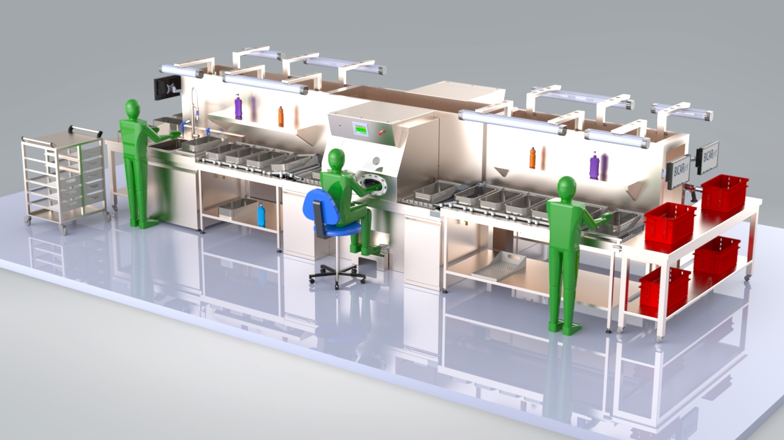
STK 102
LINE

Slide 30
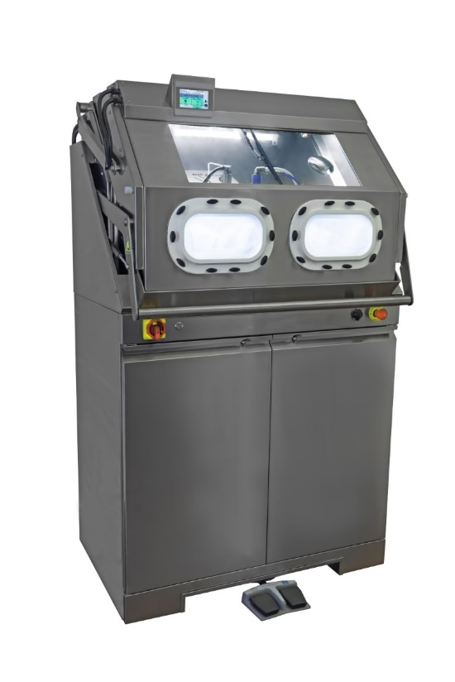
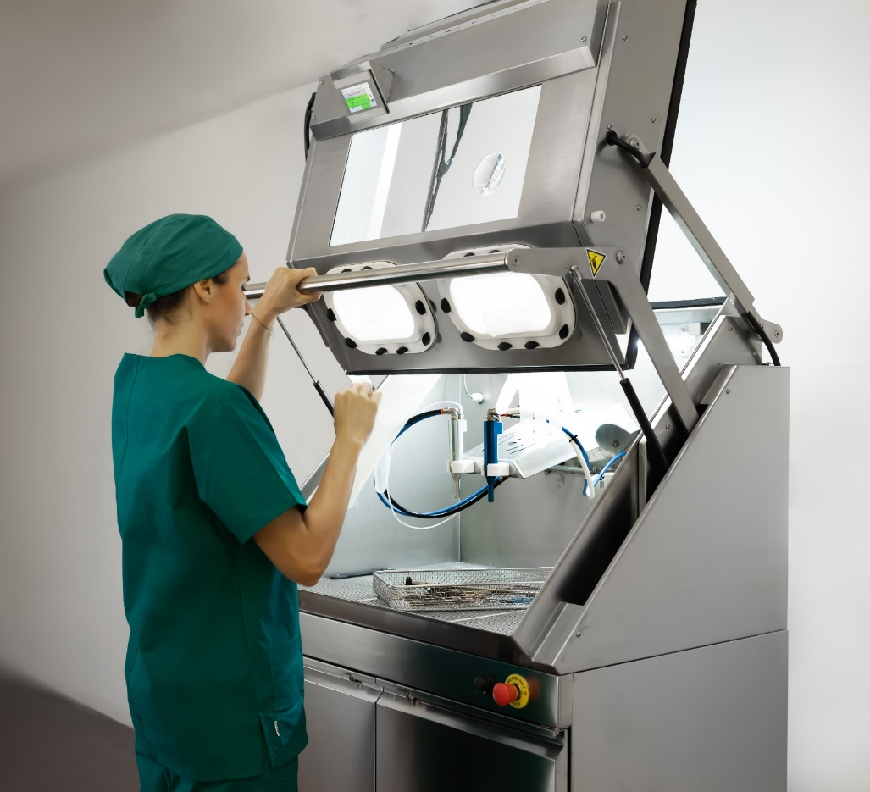
SUGGEST FOR SMALL SPACES
LOW WORKFLOW
STANDING WORK
EXTERNAL CONTROL PANEL
SAFE CleanBox
STK100

Slide 31
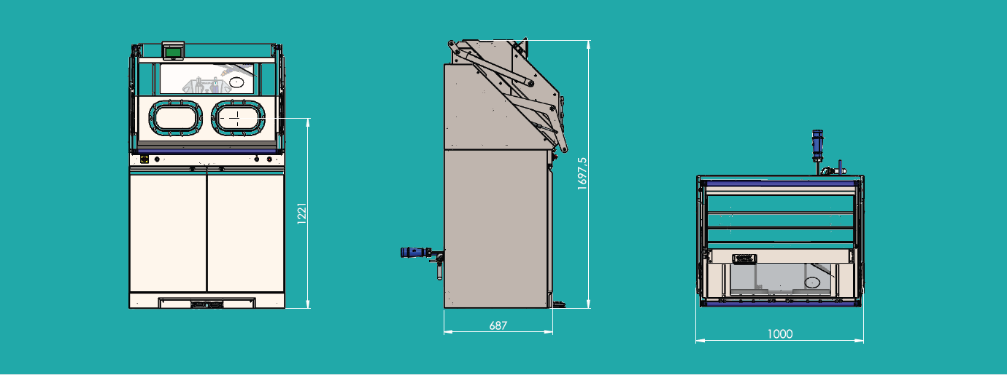
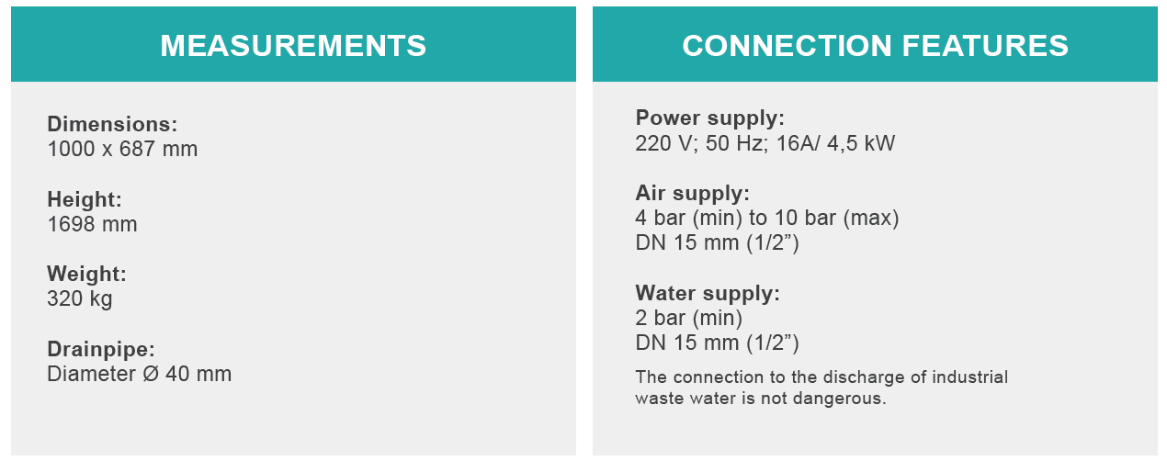
STK 100
CONNECTIONS AND MEASUREMENTS

Slide 32
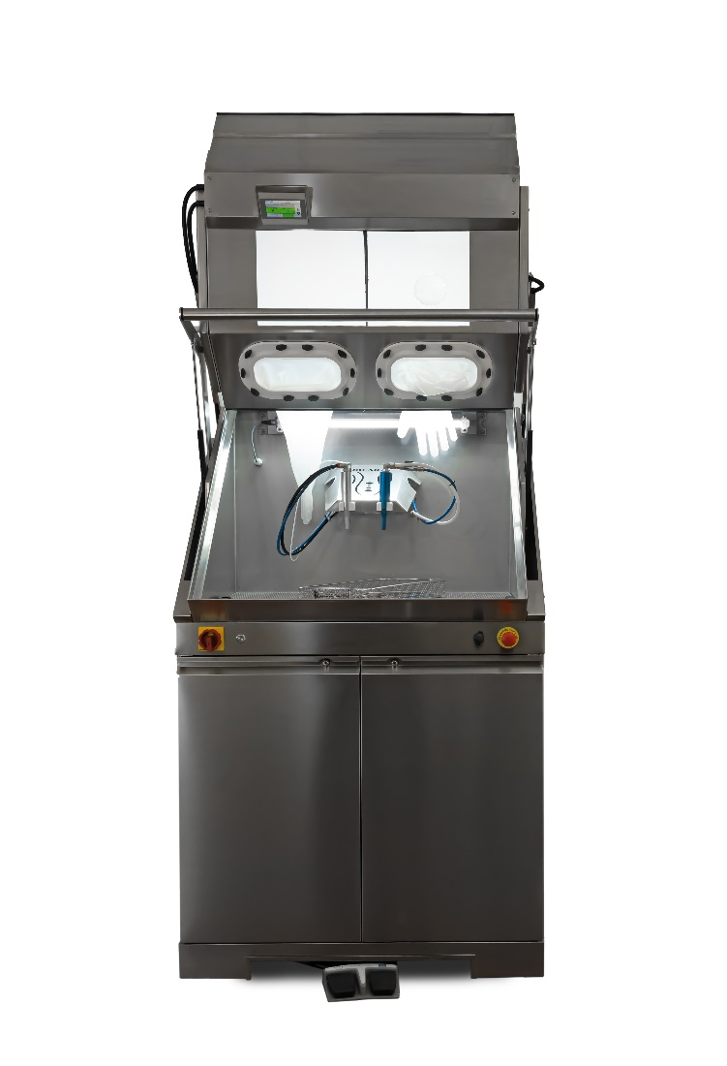
STK 100
FIELD OF APPLICATION
SAFE
CleanBox STK 100 is studied solution for the pre-treatment of RMDs in all contexts in which the storage and / or transit time results prolonged.
SAFE CleanBox STK 100 prevents dirt from becoming permanently sticked, thus preventing oxidation or sticking of organic material (biofilm).
Immediate cleaning of the instruments also allows to reduce the stress caused by the halides partially present in biological and physiological liquids.

Slide 33
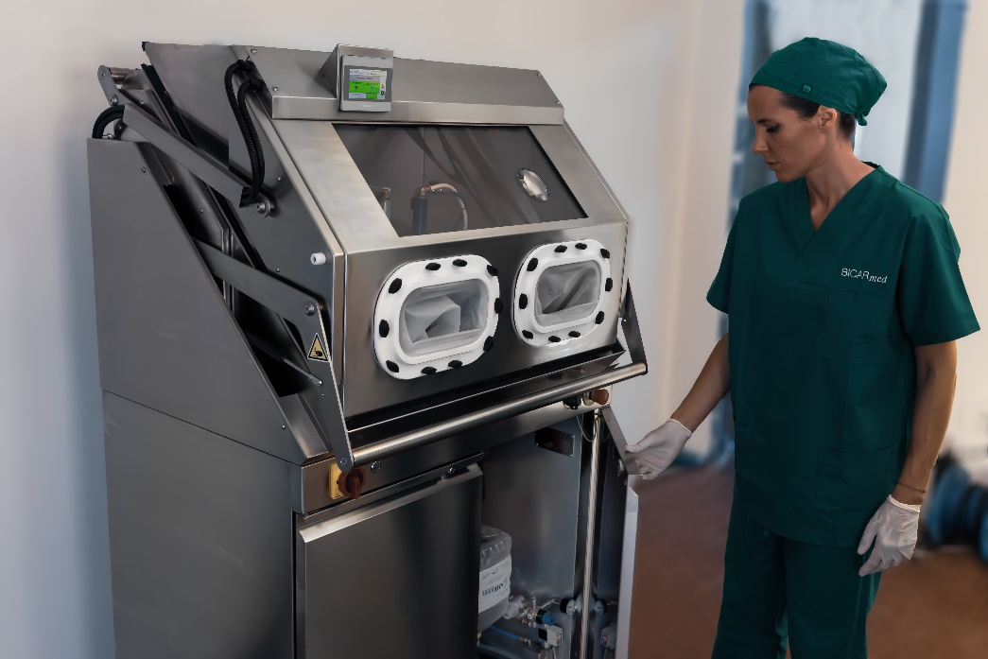
STK 100
FIELD OF APPLICATION
Machine has following placings:
Sub-sterilization central
Specialistic operating rooms
Maintenance laboratories

Slide 34
CERTIFICATIONS AND PATENTS
Made in Italy
ALL SAFE CleanBox Models are CE certified and marked as Class I Medical Devices, in compliance with European Directive 2017/745/EEC.
BICARmed ® holds 4 registered and recognized patents.

Slide 35
CONSUMABLE
SAFEKlinic Sodium Bicarbonate
SANYSAFE

Slide 36
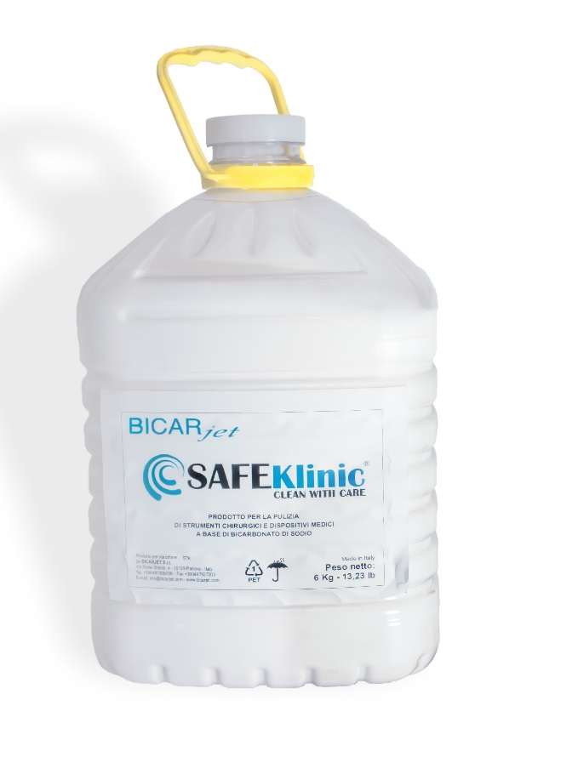
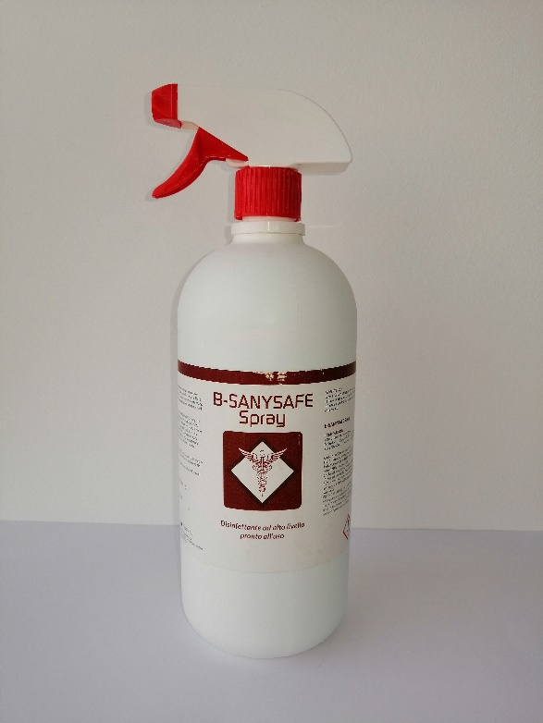
CONSUMABLES
SAFEKlinic Sodium bicarbonate and Sanysafe

Slide 37
BEFORE AND AFTER
CLEANING EXAMPLES

Slide 38




Organic tissues fixed on FORCEPS
Before BICARmed treatment
After BICARmed treatment
Organic tissues fixed on
FORCEPS
After BICARmed treatment
Before BICARmed treatment
After BICARmed treatment

Slide 39




Organic tissues fixed on ACETABULUM backside
Before BICARmed treatment
After BICARmed treatment
Organic tissues fixed on
ACETABULUM
backside
After BICARmed treatment
Before BICARmed treatment
After BICARmed treatment

Slide 40




Oxidation on GRIPPER CLAMP
Before BICARmed treatment
After BICARmed treatment
Organic tissues fixed on
DRILL BIT
After BICARmed treatment
Before BICARmed treatment
After BICARmed treatment

Slide 41




Organic tissues fixed on
MONOPOLAR TWEEZERS
Before BICARmed treatment
After BICARmed treatment
Organic tissues fixed on
MONOPOLAR TWEEZERS
After BICARmed treatment
Before BICARmed treatment
After BICARmed treatment

Slide 42




Organic tissues fixed on
BIPOLAR TWEEZERS
Before BICARmed treatment
After BICARmed treatment
Organic tissues fixed on
BIPOLAR TWEEZERS
After BICARmed treatment
Before BICARmed treatment
After BICARmed treatment

Slide 43




Organic tissues fixed on
ENDOSCOPIC FORCEPS
Before BICARmed treatment
After BICARmed treatment
Organic tissues fixed on
ENDOSCOPIC FORCEPS
After BICARmed treatment
Before BICARmed treatment
After BICARmed treatment

Slide 44




Organic tissues fixed on
ENDOSCOPIC FORCEPS
Before BICARmed treatment
After BICARmed treatment
Organic tissues fixed on
ENDOSCOPIC FORCEPS
After BICARmed treatment
Before BICARmed treatment
After BICARmed treatment

Slide 45




Organic tissues fixed on ENDOSCOPIC FORCEPS
Before BICARmed treatment
After BICARmed treatment
Organic tissues fixed on
LAPAROSCOPIC FORCEPS
After BICARmed treatment
Before BICARmed treatment
After BICARmed treatment

Slide 46




Organic tissues fixed on
DA VINCI
ROBOT
Before BICARmed treatment
After BICARmed treatment
Organic tissues fixed on
DA VINCI
ROBOT
After BICARmed treatment
Before BICARmed treatment
After BICARmed treatment

Slide 47




Organic tissues fixed on
DA VINCI
ROBOT
Before BICARmed treatment
After BICARmed treatment
Organic tissues fixed on
DA VINCI
ROBOT
After BICARmed treatment
Before BICARmed treatment
After BICARmed treatment

Slide 48




Organic dried tissues fixed on RIGID OPTIC
Before BICARmed treatment
After BICARmed treatment

Slide 49
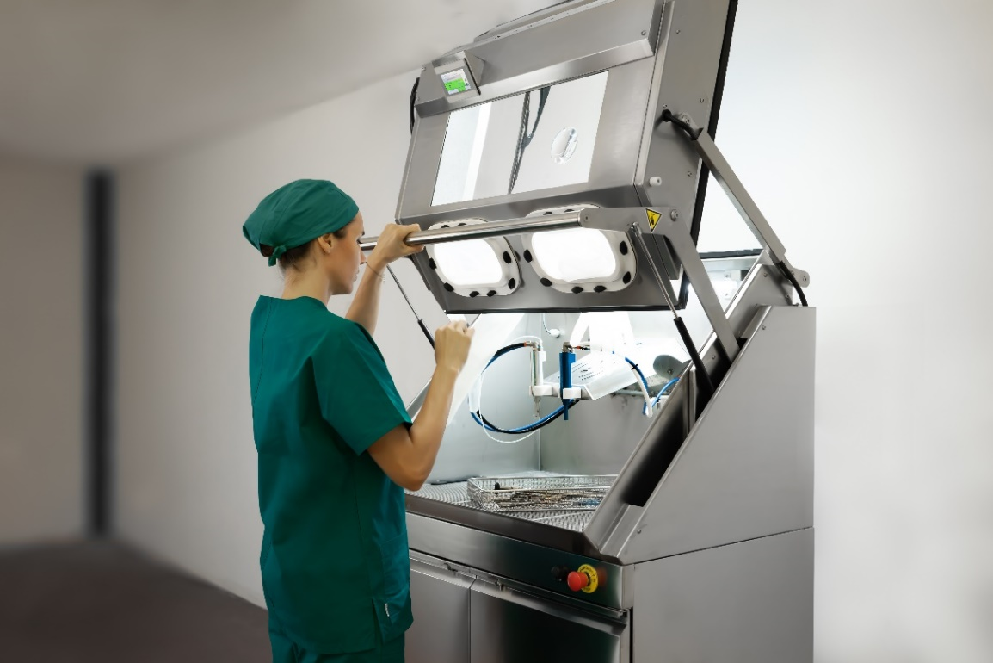
ALL THE CLEANING OPERATIONS
CAN BE DONE WITH THE SAME TECHNOLOGY
COMFORTABLY SEATED
WITHOUT WASTING TIME

Slide 50
BICARmed PRICE LIST

Slide 51
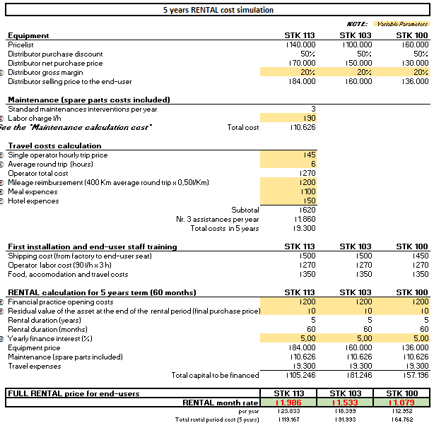
PRICE LIST
Two options
Sale → Price List
Rental → Rental Simulation (1- 5 years)

Slide 52
TECHNICAL MANUALS

Slide 53
TECHNICAL MANUALS
Important to read
Use and maintenance Manual
Specialized Technical Manual
Preventive Maintenance Program

Slide 54
USE AND MAINTENANCE MANUAL
WHO:
  To be given to the CSSD managers
WHAT:
  Installation
  Method of use
  Maintenance
  Cleaning
  Disposal
  Technical features
  Labellings
  Tutorial on correct cleaning of the instruments
  Software (HMI Panel) manual
  Pre-set users/passords

Slide 55
SPECIALIZED TECHNICAL MANUAL
WHO:
  To be given to the technicians
WHAT:
  Installation guide - connections
  Maintenance (routine, preventive activities, parts replacements)
  Cleaning
  Technical assistance
  Warranty terms and conditions
  Replacement guide
  Alarms
  Disposal
  Labellings
  Software (HMI Panel) manual

Slide 56
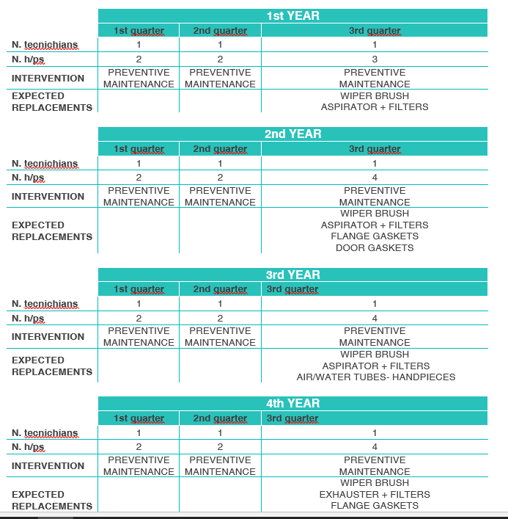
PREVENTIVE MAINTENANCE PROGRAM
WHO:
  Dealer
WHAT:
  N. tecnichans
  N. H/ps
  Intervention
  Expected Replacements

Slide 57
MARKETING

Slide 58
MARKETING TOOL
BICARMED ADVERTISING ACTIVITIES
  Magazine: Publishing and ADV on Zental Sterilizations
  Fair: Medical Expo (Düsseldorf – Germany)
  Congress: WFHSS
  Medical Expo Portal
TOOLS:
  Brochures
  Photos and Video
  Roll up
  Scientific Documents
INTRANET
Here you find all marketing and sales documents
WEB MEETING ON DEMAND

Slide 59
MARKETING ADVICES
WEB SITE
  Add a page with Bicarmed Solutions
EVENTS:
  Take part to our Exhibition and congress:
    it should be a good chance to know better our products and to get more informations
  Let we know which are the local congress in your country:
    we will give you support

Slide 60
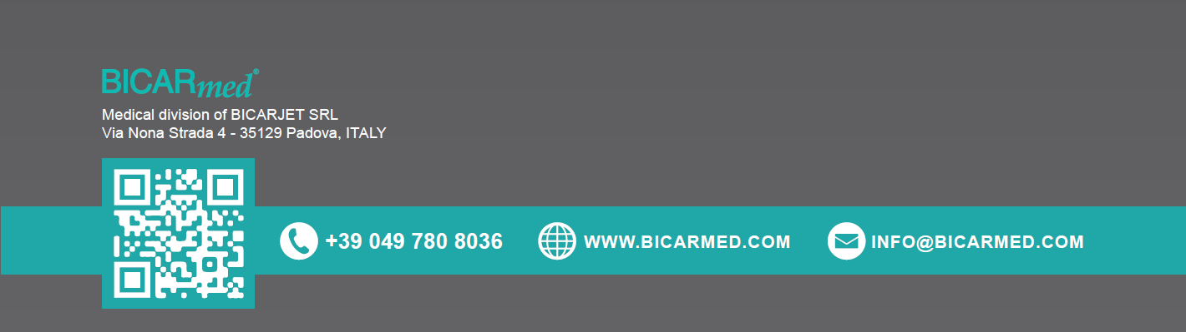
THANKS FOR YOUR ATTENTION

